Slide 1

Programming Fundamentals Using Python

Slide 2
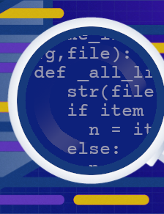
Lifecycle of Python Programs
Once a program is saved and ran using python3 command, there are a lot things which happen in the background.
These include compilation of python program and interpretation of the bytecode generated after compilation.

Slide 3
Lifecycle of Python Programs
The diagram below depicts how a what happens when you run a python program.

Slide 4
Flow Charts
Flow Charts are a way of representing a task using signs and symbols.
They help us in understanding how exactly a program is structured and can aid us in identifying a problem before the task is implemented using a programming language.

Slide 5
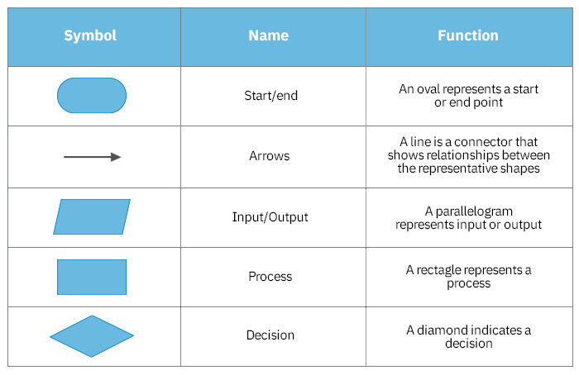
Flow Charts
These are a few symbols which can be used for creating a flow chart.

Slide 6
Pseudo code
Pseudo code as the name suggest is a way of implementing the task using English language.
It helps the users in forming guide for building a program in a language before implementing it using any specific language.

Slide 7
Conditional Statements
Conditional Statements in a program are statements which define the flow of the statements.
They control the flow of the program execution and decide which part of the program will be executed next.
They can be used create decision-based program.

Slide 8
Conditional Statements
There are mainly four kinds of conditional statements in python:
if statements
if-else statements
if-elif-else statements
Nested if-else statements

Slide 9
Iterative/Looping Statements
Iterative/Looping statements are used to repeat a certain task.
There are two kinds of iterative/looping statements in Python:
for statements
while statements

